Slide 1
FINAL INTERNSHIP PROJECT
Retail Sales Data Analysis
From raw data to business insight
Data acquisition and cleaning | Analysis | Interactive dashboard | Business insights
626 orders | 365,723.12 revenue | 11 Jan 2024 to 09 Dec 2026
Prepared by [Intern name] | Swynex | Final submission
Notes:
Final project presentation covering all four internship tasks: data sourcing and cleaning, analysis, interactive dashboard, and business insights.

Slide 2
OVERVIEW
Agenda
What this presentation covers
The problem statement and the business questions behind the project
The dataset: what it contains and how trustworthy it is
The cleaning process, including two silent defects that were fixed
The analysis: markets, categories, trend, payments and customers
The interactive dashboard built in Task 3
Key business insights and recommendations
Notes:
Six sections, roughly ten minutes, with time for questions at the end.

Slide 3
SECTION 1
Problem Statement
Why this project was needed
Sales data arrives from several systems as a single flat file, mixing transactional records with pasted reporting fragments.
The raw file cannot be queried or charted safely: a displaced header, missing values typed as text, inconsistent country names and dates stored as strings.
Every figure taken directly from the raw file is therefore unreliable.
The business questions
Which markets and product categories generate the most revenue?
Is revenue growing, flat or declining once data coverage is accounted for?
How do customers pay, and do they come back?
Notes:
Frame the problem as a decision-quality issue, not a data-entry complaint. Each question maps to a real decision: prioritisation, forecasting, retention.

Slide 4
SECTION 2
The Dataset at a Glance
Source: messy_retail_orders.csv as supplied for Task 1
626
Orders
365,723.12
Total revenue
584.22
Average order value
577
Customers
25
Products
Attribute | Detail
Period covered | 11 Jan 2024 to 09 Dec 2026
Fields in file | 15 columns, of which only 12 are real data
Structural defect | Header on line 2 under a blank row; a pivot table pasted into columns N-P
Missing values | 198 cells, all stored as the literal text 'NA'
Data integrity | 0 duplicate records; Sales reconciles on all 626 rows
Notes:
Note that the row count is sound and Sales reconciles perfectly - the problems are in labels, types and coverage, not in the numbers.

Slide 5
SECTION 3
Data Quality: What Was Wrong
198 cells stored the literal text 'NA' instead of being left empty
Notes:
Because 'NA' is text, a chart reads it as a real category. The dashboard showed 'NA' as if it were a country, ranked alongside Australia and India.

Slide 6
SECTION 3
The Cleaning Process
Ten documented, reproducible steps - no value was invented
# | Issue found | Action taken | Result
1 | Header sat under a blank first line | Skipped the blank line | 626 rows, 12 columns
2 | Pivot table pasted into columns N-P | Kept the 12 core fields | 12 clean columns
3 | Missing values stored as text 'NA' | Converted to true nulls | 198 cells fixed
4 | England and UK used for one market | Merged; blanks to Unknown | UK total corrected
5 | Blank payment methods would vanish | Labelled Unknown, retained | 36 rows retained
6 | Numbers stored as text | Coerced to numeric types | Types correct
7 | Dates stored as dd/mm/yy text | Parsed; added Year and Month | 626 dates parsed
8 | Sales is a derived field | Checked Quantity x UnitPrice | 626/626 reconcile
9 | Records in arbitrary order | Sorted by OrderID | Stable order
10 | Stray whitespace in text fields | Trimmed every text field | Clean text
Notes:
Walk through the three that matter most: the 'NA' sentinel, the country labels, and the date parsing. The rule applied throughout: correct what is provably wrong, label what is merely missing, never invent a value.

Slide 7
KEY FINDING
Correction 1: The UK Was Understated
'England' and 'United Kingdom' were two labels for one market
UK before: 56,115.69 (rank 5) + England: 13,630.14 = UK after: 69,745.83 (rank 2)
Notes:
Only the United Kingdom changes, but the change is decisive: the merged UK is 69,745.83 and moves from rank 5 to rank 2, ahead of India and Canada.

Slide 8
KEY FINDING
Correction 2: The Coverage Problem
Orders per month - 2024 only fills up from October, and 2026 stops on 09 December
Whole-year totals are not comparable. Any year-on-year chart built on them is measuring the extract window, not the business.
Notes:
2024 records only 29 orders between January and September, then 71 in the final quarter. 2026 records 23 orders after September against 78 in the same 2025 quarter. Only 2025 is complete and evenly distributed.

Slide 9
KEY FINDING
The Business Is Flat, Not Declining
Like-for-like comparison for the months both years fully cover
Naive whole-year view: +187% then -21.8%. Like-for-like: -0.3% revenue, +2.3% average order value.
Notes:
Revenue is flat at -0.3%, order count is down 2.5% and average order value is up 2.3%. The reported 21.8% decline for 2026 was a truncated extract.

Slide 10
ANALYSIS
Revenue by Market
Five markets, each holding 16.7% to 21.5% of revenue
Notes:
A balanced portfolio, not a concentrated one. Unknown represents 8.5% of revenue with no destination recorded.

Slide 11
ANALYSIS
Revenue by Category
A flat mix - no category is the growth engine
Notes:
All five categories sit between 16.7% and 21.1% of revenue. Beauty has the highest average order value at 615.56 despite ranking fourth on revenue.

Slide 12
ANALYSIS
Payment Methods
Broad-based, with credit card leading but nothing dominant
Credit card leads at 31.9% of orders.
Cash on delivery still carries 20.3% - a real reconciliation and fulfilment cost.
Every named method holds at least 12.8%, so there is no single point of failure.
5.8% of orders have no payment method recorded.
586
distinct cities
Top 10 = 5.9% of revenue
Notes:
Credit card leads on revenue as well as order count. The operational question is the cost of cash on delivery at a fifth of orders.

Slide 13
ANALYSIS
Product Concentration
The top ten products sit in a narrow band - no hero product
Notes:
The leading product is only 5.8% of revenue across 25 products. Range decisions should be driven by margin and availability, not by chasing a breakout product.

Slide 14
ANALYSIS
Geographic Fragmentation
Below country level the data stops being actionable
Notes:
586 distinct shipping cities, and the top ten together are only 5.9% of revenue. The largest city records two orders.

Slide 15
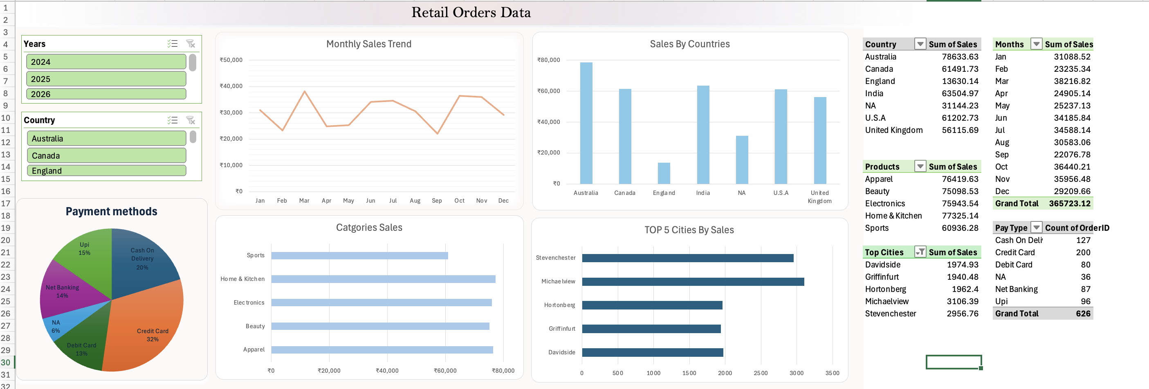
SECTION 4
The Interactive Dashboard
Delivered in Task 3 as a Tableau workbook (Dashboard.twb)
Year and Country filters drive every view at once. Two defects are corrected in this report: the split UK market, and 'NA' charted as if it were a country.
Notes:
The dashboard is interactive and well structured; the errors were in the data, not the design. Correcting the source fixes both without rebuilding the dashboard.

Slide 16
SECTION 5
Key Business Insights (1 of 2)
1
Trading is flat, not declining
Like-for-like Jan-Aug revenue moves -0.3% and average order value rises +2.3%. The reported 21.8% fall is a truncated extract.
2
The UK is the second-largest market, not the fifth
Merging England into the UK produces 69,745.83, 19.1% of revenue, ahead of India and Canada.
3
There is no customer retention
577 customers, 626 orders, zero repeat purchases. All revenue is first-time revenue.
4
The product mix is flat - no hero product
All five categories fall between 16.7% and 21.1% of revenue; the top product takes only 5.8%.

Slide 17
SECTION 5
Key Business Insights (2 of 2)
5
Revenue moves with order count, not basket size
Average order value is stable at 584.22 while monthly order counts ranged from 16 to 32.
6
City-level reporting is not actionable
586 cities; the top ten are 5.9% of revenue.
7
Payment is broad-based, credit card leads
Credit card 31.9% of orders, cash on delivery 20.3%, every method at least 12.8%.
8
8.5% of revenue has no market recorded
52 orders worth 31,144.23 cannot be attributed geographically.

Slide 18
SECTION 6
Recommendations
Prioritised actions arising from the analysis
# | Recommendation | Why | Priority
1 | Enforce country as a controlled list at capture | Recovers the 8.5% of unattributed revenue | High
2 | Introduce a customer ID and instrument repeat purchase | Retention cannot currently be measured | High
3 | Standardise the reporting window; compare like for like | Partial years produced a false 21.8% decline | High
4 | Validate findings against production data | The dataset looks synthetic | High
5 | Replace the city panel with market reporting | 586 cities, 5.9% top-ten share | Medium
6 | Adopt the corrected market ranking onward | The UK moves from fifth to second | Medium
7 | Add automated data-quality checks to the pipeline | Both defects were silent, not errors | Medium
8 | Quantify the cost of cash on delivery | 20.3% of orders | Medium

Slide 19
SECTION 7
Limitations and Takeaway
What bounds these conclusions
Data quality. The dataset appears synthetic: example.com emails, generated city names, and 626 orders from 626 distinct customers.
Scope. No currency, no cost or margin fields, and no order status - this is revenue analysis only, not profitability.
Coverage. 2024 and 2026 are partial, so only like-for-like windows support trend statements.
Residual gaps. Some gaps are retained rather than imputed: 110 cells remain missing and 124 order IDs are absent from the sequence.
The takeaway
The business is balanced and stable: five markets and five categories of similar size, and flat trading once coverage is corrected. The real risk is that two silent data defects had been producing confident, wrong answers - which is the argument for the data-quality controls recommended here.

Slide 20
Thank you
Questions and discussion
Swynex Final Project | Retail Sales Data Analysis | Cleaned, analysed and documented
Notes:
Close by inviting questions on the two corrections, since those are the most consequential findings.

